Slide 1
Azure Container Apps

Slide 2
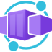
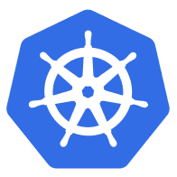



Azure Container Apps
Serverless containers for microservices
Build modern apps on open source
Focus on apps, not infrastructure
Seamlessly port to Kubernetes
Kubernetes
KEDA
DAPR
Envoy
Notes:
We’re constantly seeing customers citing Kubernetes complexity as a blocker from adopting containers and microservices application patterns.
At Microsoft Ignite, we announced the public preview of Azure Container Apps.
Azure Container Apps is built on a foundation of powerful open-source technology to deliver the same microservices benefits as Kubernetes as a fully managed and serverless app hosting option. Behind the scenes, every container app runs on Azure Kubernetes Service, with Kubernetes Event Driven Autoscaling (KEDA), Distributed Application Runtime (Dapr), and Envoy deeply integrated in the hosting service. However, developers and operators are not exposed to this underlying Kubernetes infrastructure. The open-source centric approach enables a path for teams to build microservices without having to overcome the concept and operational overhead of working with Kubernetes directly and enables continued app portability by leveraging open standards and APIs

Slide 3
What can you build with Azure Container Apps?
Public API endpoints
Web
Apps
Event-driven processing
Background processing
Microservices
MICROSERVICE A
MICROSERVICE B
HTTP TRAFFIC
MICROSERVICE C
80%
20%
REVISION 1
REVISION 2
Microservices architecture with the option to integrate with Dapr
E.g., API app with HTTP requests split between two revisions of the app
E.g., Web app with custom domain, TLS certificates, and integrated authentication
E.g., Queue reader app that processes messages as they arrive in a queue
E.g., Continuously running background process transforms data in a database
AUTO-SCALE CRITERIA
Individual microservices can
scale independently using any KEDA scale triggers
Scaling is determined by the number of concurrent HTTP requests
Scaling is determined by the number of concurrent HTTP requests
Scaling is determined by the number of messages in the queue
Scaling is determined by the level of CPU or memory load
Notes:
You may be wondering what sort of applications can you build with Azure Container Apps?
Here are some common ones including:
Deploying API endpoints
Hosting background processing applications
Handling event-driven processing
Running microservices
With each of those applications, you can dynamically scale based on:
HTTP traffic
Event-driven processing
CPU or memory load
Any KEDA-supported scaler

Slide 4
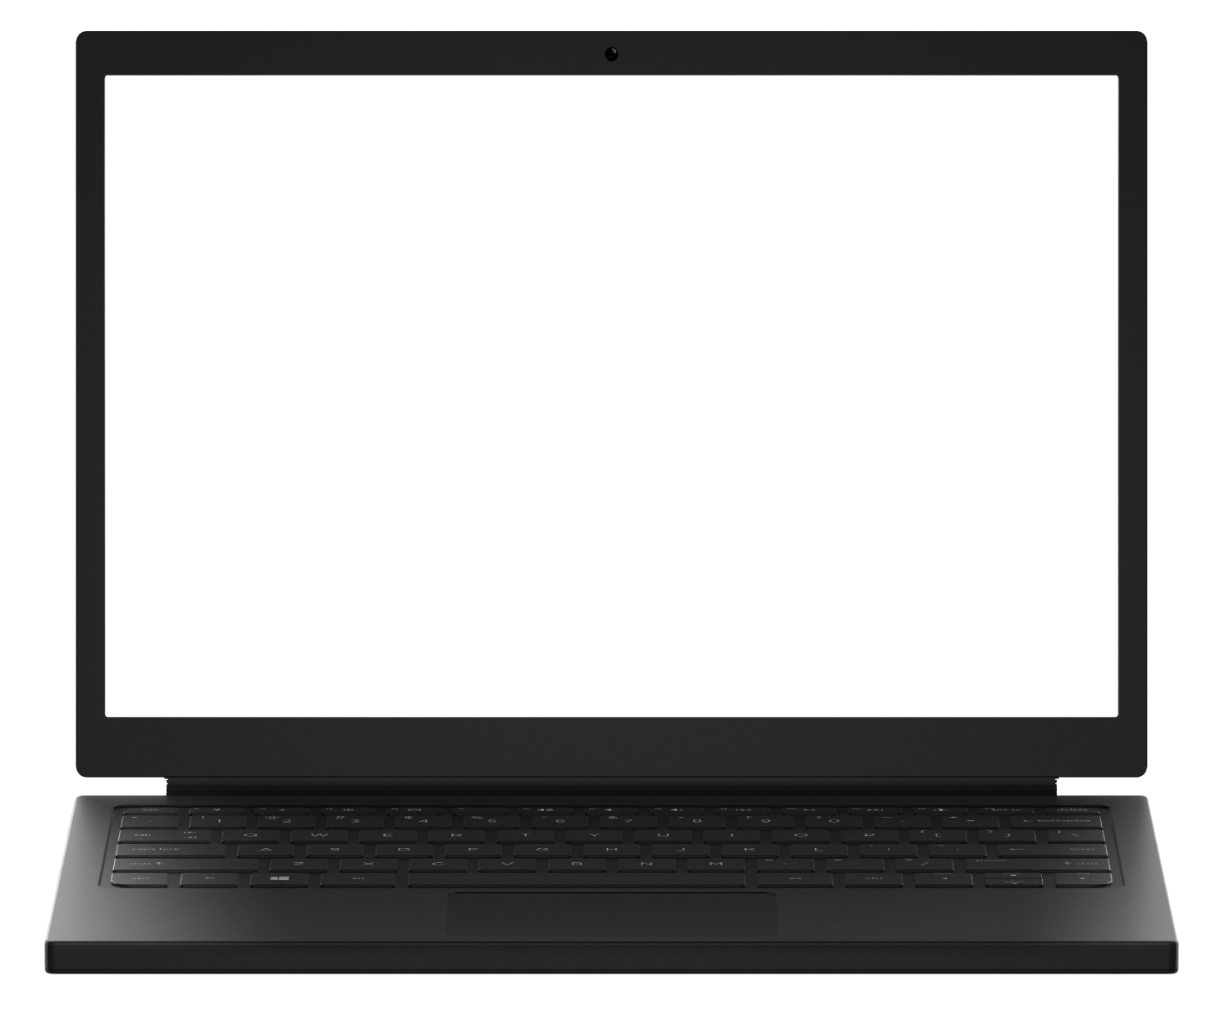
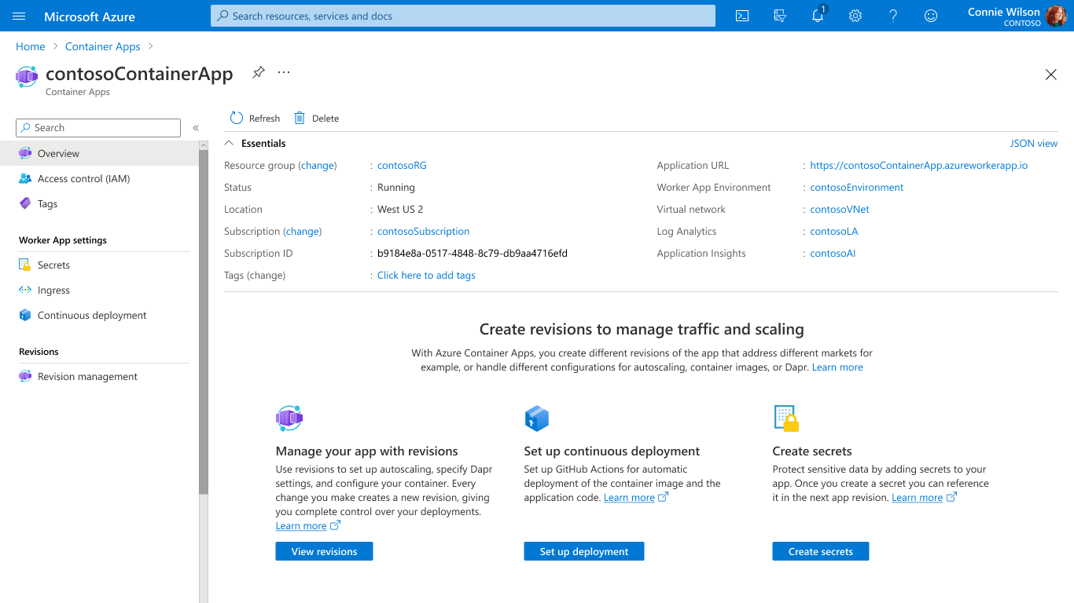
Scale with flexible serverless containers
Run containers, at scale
Accelerate developer productivity
Build modern apps on open-source
Run containers and scale in response to HTTP traffic or a growing list of KEDA-supported scale triggers including Azure Event Hub, Apache Kafka, RabbitMQ Queue, MongoDB, MySQL, and PostgreSQL
Get robust autoscaling capabilities without the overhead of managing complex infrastructure.
Scale to zero and pay for only what you use, by the second.
Notes:
Container Apps is the only serverless container solution offering a combination of robust built-in HTTP-based auto-scaling (including scale to zero), and event-driven auto-scale to run containers that may be processing messages from queues, streams, or databases.
You can run containers and scale in response to HTTP traffic or a growing list of KEDA-supported scale triggers including Azure Event Hub, Apache Kafka, RabbitMQ Queue, MongoDB, MySQL, and PostgreSQL. Scale to zero and pay for only what you use, by the second.

Slide 5
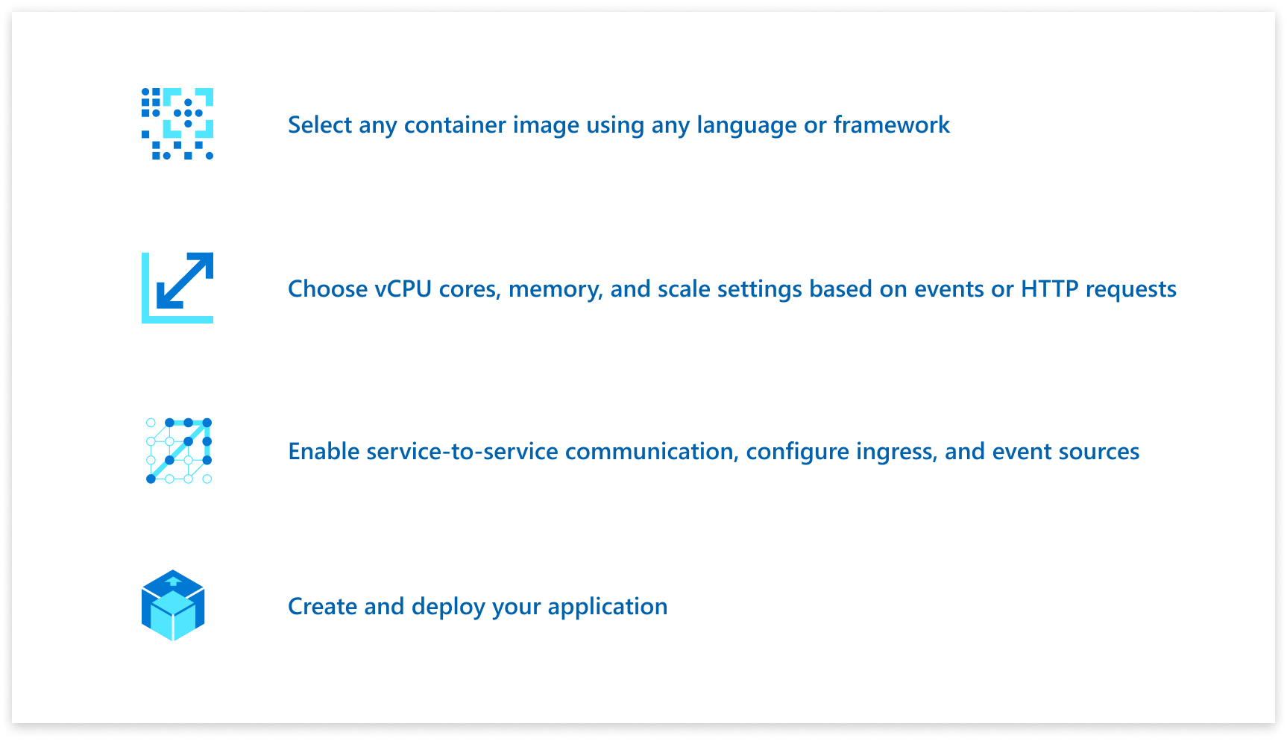
Accelerate developer productivity
Run containers, at scale
Accelerate developer productivity
Build modern apps on open-source
Build microservices, APIs, event processing workers, and background jobs using containers.
Write code in your favorite programming language and accelerate development with built-in Distributed Application Runtime (Dapr) integration to simplify common tasks like event processing, pub/sub, and service invocation.
Set up a code-to-cloud pipeline using GitHub Actions.
Notes:
Because you’re not burdened by managing a container orchestrator, this gives you more time to focus on building your applications. With Container Apps, you can build microservices, APIs, event processing workers, and background jobs using containers and any programming language or framework and easy code-to-cloud pipeline using GitHub Actions.
Through the built-in integration with Distributed Application Runtime (Dapr), you can simplify common tasks like event processing, pub/sub, service invocation, and more.

Slide 6
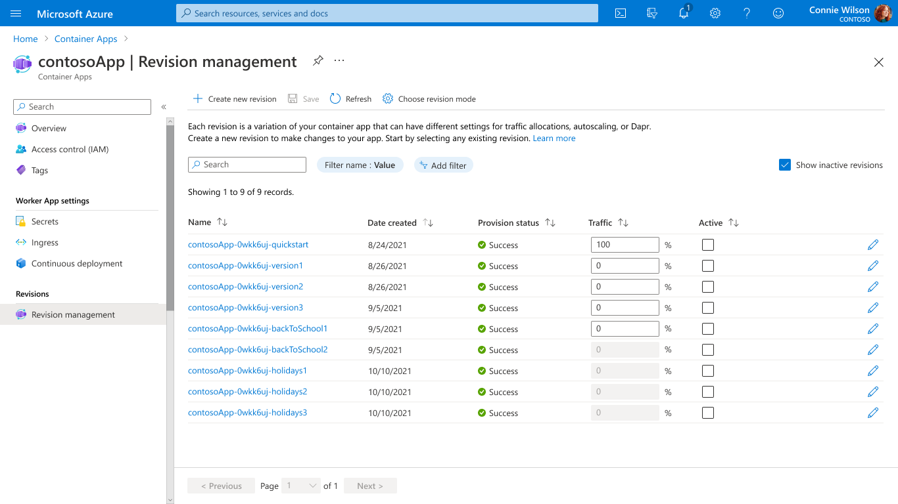
Build modern apps on open-source
Run containers, at scale
Accelerate developer productivity
Build modern apps on open-source
Create modern apps with open standards on a Kubernetes foundation and portability in mind.
Contribute directly to OSS projects to influence product capabilities.
Rely on streamlined application lifecycle tasks such as application upgrades and versioning, traffic shifting, service discovery, and monitoring.
Notes:
Container Apps is built on great open-source technology. It runs on top of Azure Kubernetes Service, KEDA, Dapr, and Envoy.
Perform modern application lifecycle tasks such as application upgrades, traffic shifting, and versioning with straightforward configurations. Rely on the built-in service discovery for microservice communication, fully managed HTTP and HTTP/2 ingress endpoints based on Envoy, and integrated load balancing, logging, and monitoring capabilities.

Slide 7
Azure Kubernetes Service and Azure Container Apps
Azure customers can easily deploy microservices using either Azure Kubernetes Service for flexible customized container solutions, or Azure Container Apps for productivity-optimized fully-managed serverless container solutions. Azure delivers app portability to support business growth powered by open-source in the Kubernetes ecosystem.
Cloud Native App Portability
Develop cloud native apps with open standards and APIs (e.g. Dapr) and port across Azure Container Apps and Azure Kubernetes Service.
Leverage Azure Container Apps guidance and tooling to port cloud native apps to Azure Kubernetes Service
Azure Container Apps is composed entirely of open source components available to build your own Azure Kubernetes Service solution.
Notes:
We’re constantly seeing customers citing Kubernetes complexity as a blocker from adopting containers and microservices application patterns.
At Microsoft Ignite, we announced the public preview of Azure Container Apps.
Azure Container Apps is built on a foundation of powerful open-source technology to deliver the same microservices benefits as Kubernetes as a fully managed and serverless app hosting option. Behind the scenes, every container app runs on Azure Kubernetes Service, with Kubernetes Event Driven Autoscaling (KEDA), Distributed Application Runtime (Dapr), and Envoy deeply integrated in the hosting service. However, developers and operators are not exposed to this underlying Kubernetes infrastructure. The open-source centric approach enables a path for teams to build microservices without having to overcome the concept and operational overhead of working with Kubernetes directly and enables continued app portability by leveraging open standards and APIs

Slide 8
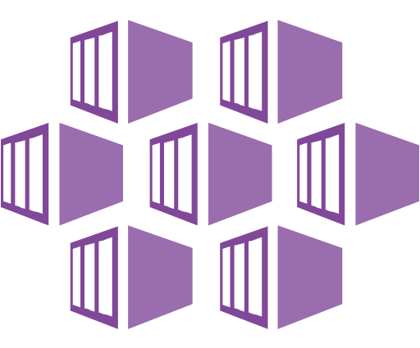
How does ACA compare to AKS?
Azure Kubernetes Service (AKS)
Azure Container Apps (ACA)
Infrastructure focus, higher flexibility
Application focus, infrastructure abstraction
Managed Kubernetes cluster in Azure with full access to the Kubernetes API server and high level of control over cluster configuration with a node-based pricing model
Fully-managed serverless abstraction on top of Kubernetes infrastructure, purpose built for managing and scaling event-driven microservices with a consumption-based pricing model
Core value proposition
Upstream feature parity with a managed control plane
Operations flexibility with advanced customization
Experienced Kubernetes operators
Platform-as-a-Service experience with serverless scale
Developer productivity with low operations overhead
Linux-based, general-purpose stateless containers
Optimized for
Operators deploy node-based AKS clusters using Azure Portal, CLI or Infrastructure-as-Code templates (IaC)
Developers deploy containers via Kubernetes deployment manifests or HELM charts to logically-isolated namespaces within the cluster
Developers deploy containers as individual Container Apps using Azure Portal, CLI or IaC templates without any Kubernetes manifests required
Related container apps are deployed to a shared Container Apps environment comparable to a Kubernetes namespace
Interaction model
Provides a set of cluster extensions and add-ons for operators to enable OSS components in-cluster including Dapr, KEDA, Open Service Mesh, GitOps (Flux), Pod Identity, etc.
Supports manual installation via Kubernetes manifests
Includes opinionated platform capabilities powered by CNCF projects including Dapr, KEDA and Envoy which are fully platform-managed and supported
Envoy: managed ingress and traffic splitting
KEDA: managed, event-driven autoscale
Dapr: codified best practices for microservices
OSS Integration
Notes:
Flexibility vs productivity

Slide 9
Deep dive
Notes:
Now that you’ve seen how to get a container app up and running, let’s dig deeper into some of the concepts behind Azure Container Apps

Slide 10
Environments
Environment (virtual network boundary)
Container app 1
Revision 1
Revision 2
Replica
Replica
Environments define an isolation and observability boundary around a collection of container apps deployed in the same virtual network
Container(s)
Container(s)
Container app 2
Revision 1
Revision 2
Replica
Replica
Container(s)
Container(s)
Notes:
Individual container apps are deployed to a single Container Apps environment, which acts as a secure boundary around groups of container apps. Container Apps in the same environment are deployed in the same virtual network and write logs to the same Log Analytics workspace.
Reasons to deploy container apps to the same environment include situations when you need to:
Manage related services
Deploy different applications to the same virtual network
Have applications communicate with each other using Dapr
Have applications to share the same Dapr configuration
Have applications share the same log analytics workspace
Reasons to deploy container apps to different environments include situations when you want to ensure:
Two applications never share the same compute resources
Two applications can't communicate with each other via Dapr

Slide 11
Containers
Environment (virtual network boundary)
Container app 1
Revision 1
Revision 2
Replica
Replica
Replica
Replica
Containers in Azure Container Apps can use any and development stack of your choice
Container(s)
Container(s)
Container(s)
Container(s)
Container app 2
Revision 1
Revision 2
Replica
Replica
Container(s)
Container(s)
Notes:
Azure Container Apps manages the details of Kubernetes and container orchestrations for you. Containers in Azure Container Apps can use any runtime, programming language, or development stack of your choice.
Azure Container Apps supports:
Any Linux-based container image
Containers from any public or private container registry
However, Azure Container Apps can't run privileged containers or processes that requires root access.
Additional features include:
There is no required base container image.
Changes to the template ARM configuration section triggers a new container app revision.
If a container crashes, it automatically restarts.
You can define multiple containers in a single container app. Groups of containers are known as pods. The containers in a pod share hard disk and network resources and experience the same application lifecycle.
Reasons to run containers together in a pod include:
Use a container as a sidecar to your primary app.
Use of a shared disk space and virtual network.
Share scale rules among containers.
Group together multiple containers that need to always run together.
Enable direct communication among containers on the same host.

Slide 12
Revisions
Environment (virtual network boundary)
Container app 1
Revision 1
Revision 2
Replica
Replica
Replica
Replica
Revisions are immutable version snapshots of a container app
Container(s)
Container(s)
Container(s)
Container(s)
Container app 2
Revision 1
Revision 2
Replica
Replica
Container(s)
Container(s)
Notes:
A revision is an immutable snapshot of a container app.
The first revision is automatically created when you deploy your container app.
New revisions are automatically created when a container app's template configuration changes.
While revisions are immutable, they're affected by changes to global configuration values, which apply to all revisions.
Revisions are most useful when you enable ingress to make your container app accessible via HTTP. Revisions are often used when you want to direct traffic from one snapshot of your container app to the next. Typical traffic direction strategies include A/B testing and BlueGreen deployment.

Slide 13
Ingress
Environment (virtual network boundary)
Container app 1
Revision 1
Revision 2
Replica
Replica
Replica
Replica
Internal or external visibility with TLS termination and support for HTTP/1.1 and HTTP/2
Container(s)
Container(s)
Container(s)
Container(s)
80%
20%
Ingress
Notes:
Azure Container Apps allows you to expose your container app to the public web by enabling ingress. When you enable ingress, you do not need to create an Azure Load Balancer, public IP address, or any other Azure resources to enable incoming HTTPS requests.
With ingress enabled, your container app features the following characteristics:
Supports TLS termination
Supports HTTP/1.1 and HTTP/2
Endpoints always use TLS 1.2, terminated at the ingress point
Endpoints always expose ports 80 (for HTTP) and 443 (for HTTPS).
By default, HTTP requests to port 80 are automatically redirected to HTTPS on 443.
Your ingress IP and fully qualified domain name can either be visible externally to the internet, or internally within a VNET. With ingress enabled, your application is assigned a fully qualified domain name (FQDN).
Your Container Apps environment has a single public IP address for applications with external ingress visibility, and a single internal IP address for applications with internal ingress visibility. Therefore, all applications within a Container Apps environment with external ingress visibility share a single public IP address. Similarly, all applications within a Container Apps environment with internal ingress visibility share a single internal IP address. HTTP traffic is routed to individual applications based on the FQDN in the host header.

Slide 14




Environment (virtual network boundary)
Container app 1
GitHub Actions integration
Revision 1
Revision 2
Replica
Replica
Replica
Replica
Publish revisions as commits are pushed to your GitHub repository by triggering a GitHub Action to build a new container image
Container(s)
Container(s)
Container(s)
Container(s)
Build container using GitHub Action
Azure Container Registry
GitHub repository
Code check-in
Notes:
Use GitHub Actions to publish revisions to your container app. As commits are pushed to your GitHub repository, a GitHub Action is triggered which updates the container image in the container registry. Once the container is updated in the registry, Azure Container Apps creates a new revision based on the updated container image.
The github-action add command creates a GitHub Actions integration with your container app. You can also configure continuous deployment through the Azure Portal.

Slide 15
Secrets management
"template": {
"containers": [
{
"image": "myregistry/myQueueApp:v1",
"name": "myQueueApp",
"env": [
{
"name": "QueueName",
"value": "myqueue"
},
{
"name": "ConnectionString",
"secretref": "queue-connection-string"
}
]
}
],
}
Securely store sensitive configuration elements that are then available to containers through environment variables, scale rules, and Dapr
Notes:
Azure Container Apps allows your application to securely store sensitive configuration values. Once defined at the application level, secured values are available to containers, inside scale rules, and via Dapr.
Secrets are scoped to an application, outside of any specific revision of an application.
Adding, removing, or changing secrets does not generate new revisions.
Each application revision can reference one or more secrets.
Multiple revisions can reference the same secret(s).
When a secret is updated or deleted, you can respond to changes in one of two ways:
Deploy a new revision.
Restart an existing revision.

Slide 16

Logging
Environment
Container app 1
Revision 1
Revision 2
Replica
Replica
Containers write logs to standard output or standard error streams surfaced via Log Analytics
Container(s)
Container(s)
stderr/stdout
stderr/stdout
Log Analytics
Notes:
Azure Container Apps gathers a broad set of data about your container app and stores it using Log Analytics. You can then use the Azure CLI or the Azure Portal to run queries against your Log Analytics workspace and visualize the results.

Slide 17
Scaling and using the Kubernetes Event Driven Autoscaling (KEDA)

Slide 18





Application autoscaling made simple Open-source, extensible, and vendor agnostic
Metrics Adapter | Controller | Scaler
Intelligently scale your event-driven applications
Out-of-the-box scalers for various vendors, databases, messaging systems, telemetry systems, CI/CD, and more
Event-driven
Built-in scalers
Kubernetes-based Event Driven Autoscaler
Support for triggers across variety of cloud providers & products
Bring rich scaling to every workload
Vendor-agnostic
Rich capabilities
Drive the scaling of any container based on a growing list of 35+ event sources, known as: scalers
keda.sh

Slide 19
Scaling
KEDA
HTTP
Event-driven
CPU
Memory
{
"name": "http-rule",
"http": {
"metadata": {
"concurrentRequests": 50
}
}
}
artemis-queue, kafka, aws-cloudwatch, aws-kinesis-stream, aws-sqs-queue, azure-blob, azure-eventhub, azure-servicebus, azure-queue, cron, external, gcp-pubsub, huawei-cloudeye, ibmmq, influxdb, mongodb, mssql, mysql, postgresql, rabbitmq, redis, redis-streams, selenium-grid, solace-event-queue, ..
{
"name": "cpu-rule",
"custom": {
"type": "cpu",
"metadata": {
"type": "Utilization",
"value": "50"
}
}
}
{
"name": "mem-rule",
"custom": {
"type": "memory",
"metadata": {
"type": "AverageValue",
"value": "512"
}
}
}
Support for scale to zero and specifying minimum/maximum replicas
Support for specifying minimum/maximum replicas
Notes:
When it comes to scaling, you have a number of choices here, some of which support scaling to zero.
Both HTTP scaling and Event-driven scaling support scaling to zero when there are no requests, or when there are no events to process.
HTTP scaling
With an HTTP scaling rule, you have control over the threshold that determines when to scale out. You define the maximum number of concurrent requests. Once the number of requests exceeds this value, then more replicas are added, up to the maxReplicas amount.
Event-driven scaling
Container Apps can scale based of a wide variety of event types. Any event supported by KEDA, is supported in Container Apps. Examples include: …
CPU scaling
CPU scaling allows your app to scale in or out depending on how much the CPU is being used utilizing the KEDA CPU scale trigger.
Memory scaling
Memory scaling allows your app to scale in or out depending on how much memory is being used utilizing the KEDA Memory scaler
You also have a choice to set a minimum number of instances that will always be up and running. Those will then be charged at a reduced “Idle” rate as long as those applications are not processing requests.

Slide 20
Using the Distributed Application Runtime (Dapr)

Slide 21


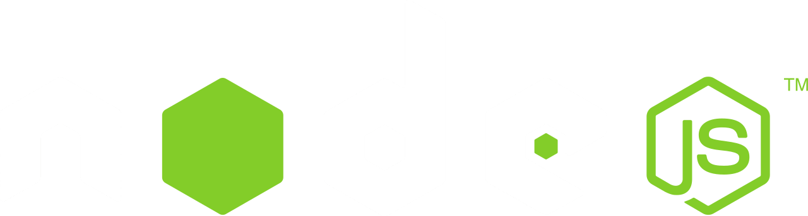



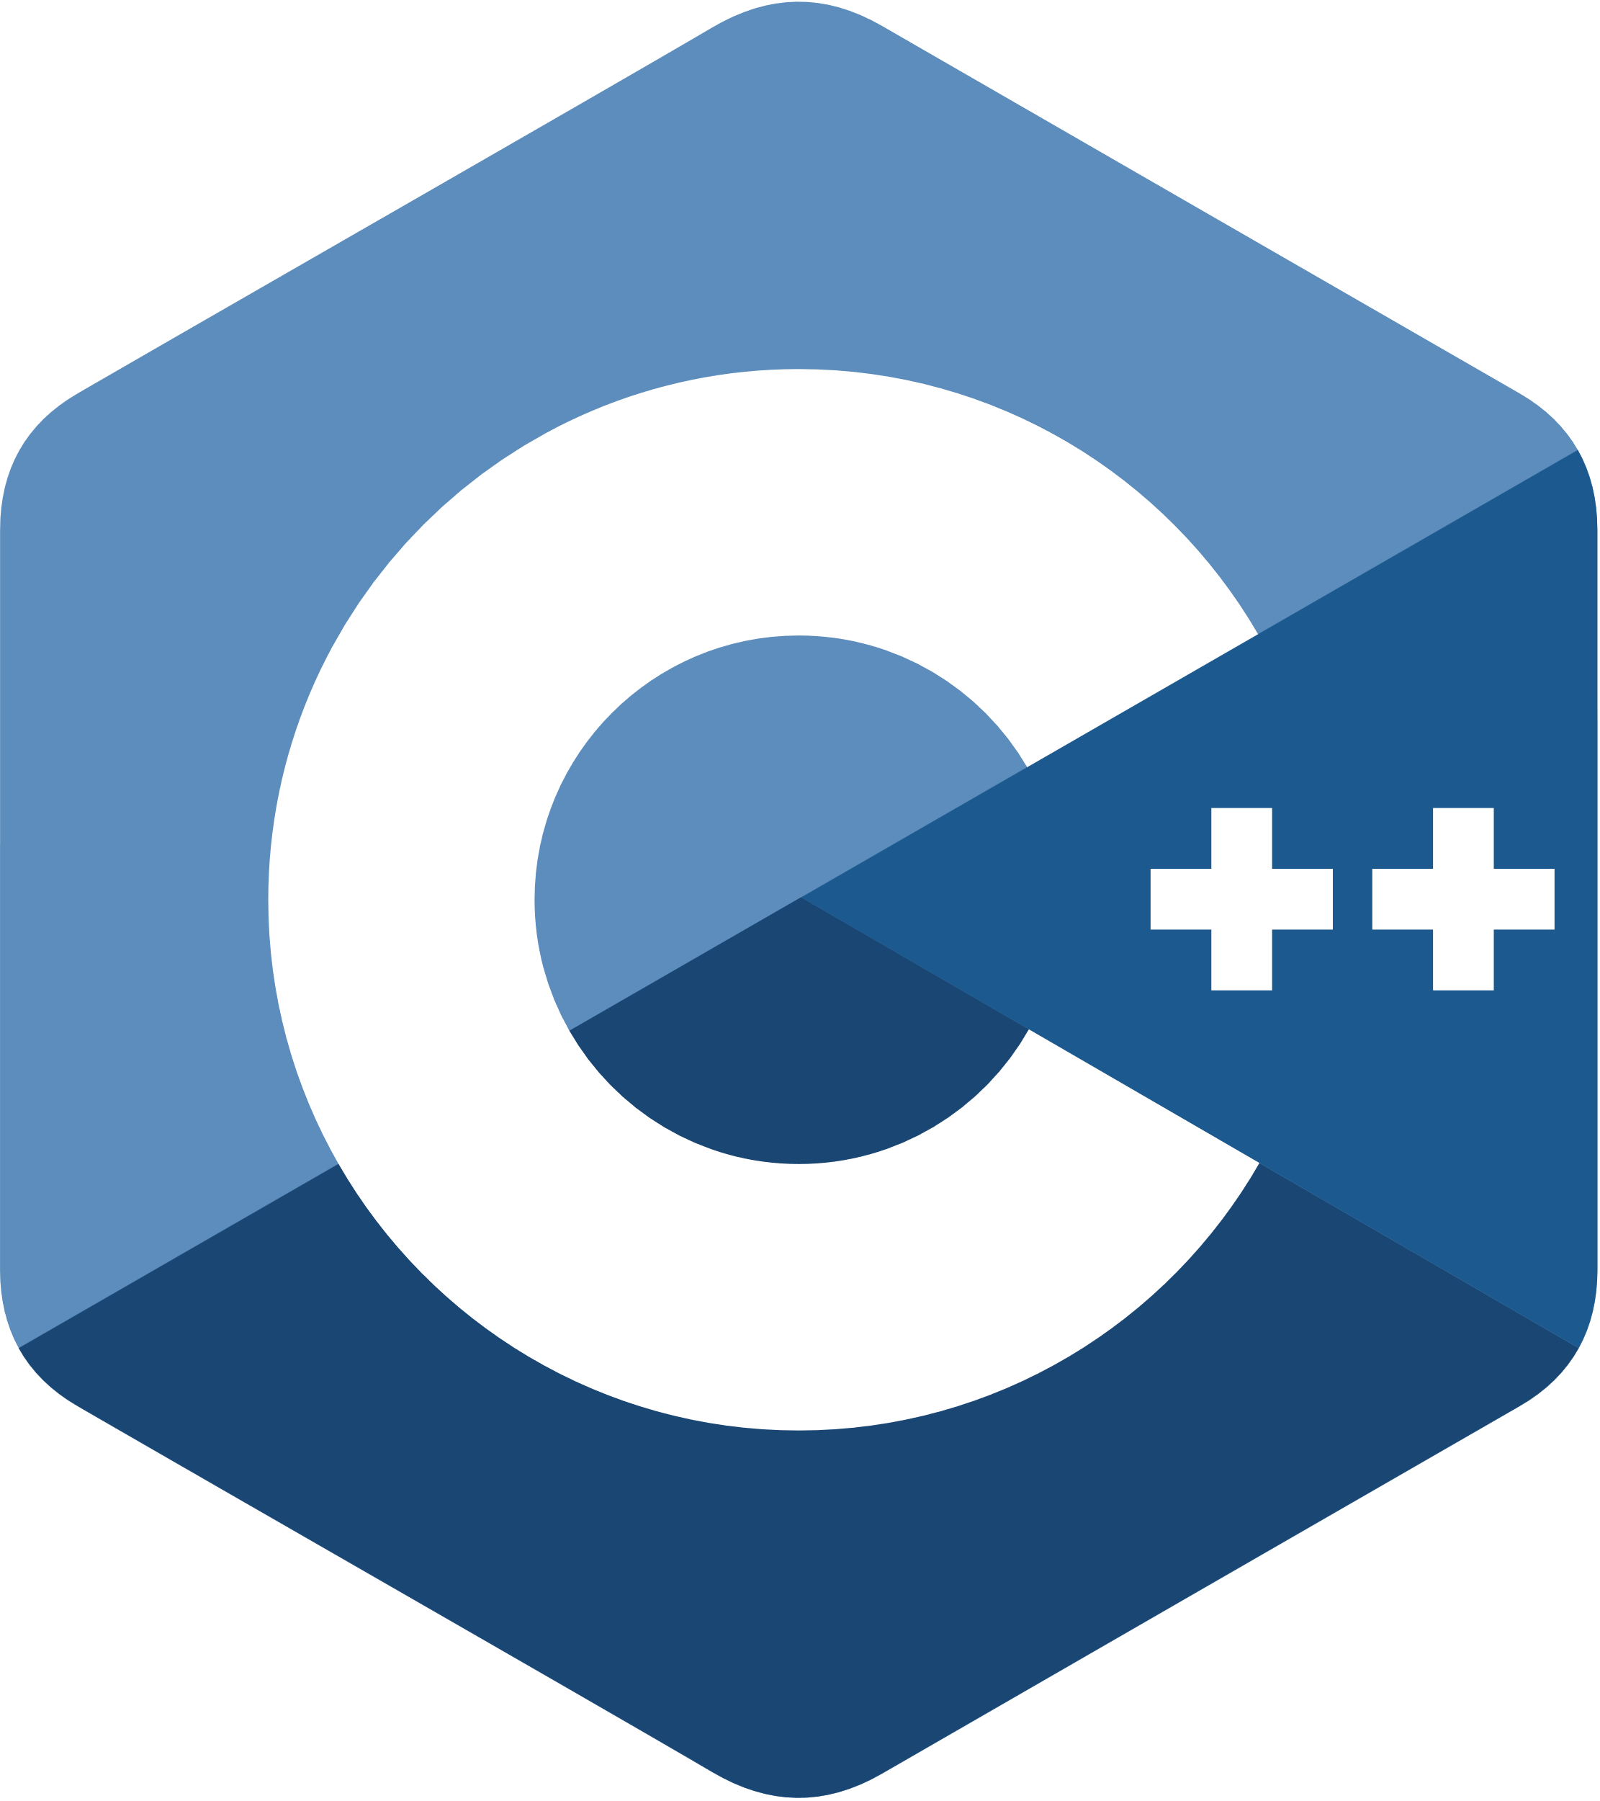
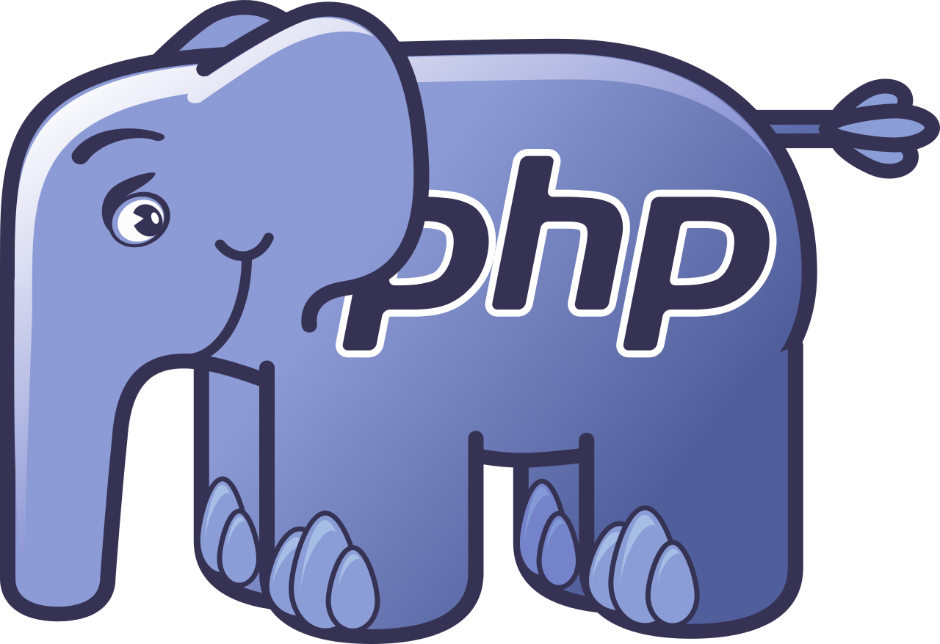







Microservices using any language or framework Any cloud or edge infrastructure
Application code
Microsoft services written in any code or framework
Distributed Application Runtime
HTTP API
gRPCz API
Service-to-service invocation
State management
Publish and subscribe
Resource bindings and triggers
Actors
Observability
Secrets
Extensible
Portable, event-driven, runtime for building distributed applications across cloud and edge
Hosting infrastructure
dapr.io
Azure Arc
On-premises
Notes:
Building microservices and distributed application is hard.
Dapr helps developers build event-driven, resilient distributed applications. Whether on-premises, in the cloud, or on an edge device, Dapr helps you tackle the challenges that come with building microservices and keeps your code platform agnostic.
Dapr is a set of APIs that makes it easy for you to write distributed applications. It runs as a sidecar process next to an application, whether on Kubernetes or any other environment, and gives you a set of primitives in the form of pub/sub, state management, secrets management, event triggers, and service-to-service calls that are secured and reliable. With Dapr, developers focus on building business logic instead of infrastructure.
The project was created in 2019 at Microsoft. Over time, many community members have joined and contributed to the project, extending it and helping it reach a stable 1.0 release in February 2021. Today, the Dapr Steering and Technical Committee governs the project with representatives from Alibaba, Intel, and Microsoft. And in November 2021, Dapr joined the Cloud Native Computing Foundation as an incubating project.

Slide 22


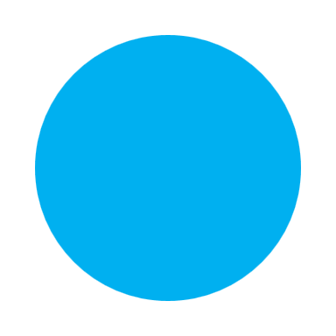
Common microservices requirements
Service to service secure communication
1.1 TLS encryption and mutual TLS authentication
1.2 Reliability and retries
1.3 Observability and distributed tracing
Independent component lifecycle: versioning and scaling
Data encapsulation and governance
(Enabled with Dapr)
(Enabled with revisions and KEDA)
(Enabled with Dapr)
Notes:
(Notes from Jeff) Azure Container Apps is purpose-built service for containers and microservices, designed so that it supports the best-practice and standard microservices patterns on Kubernetes 1:1. Even better we've been able to optimize the experience, so things like enabling identity, security, and monitoring best practices will be right at customers’ finger-tips.

Slide 23
Fully managed Dapr using the sidecar model
Containerized application
sidecar
Dapr API
HTTP of gRPC
Service-to-service invocation POST http://localhost:3500/v1.0/invoke/cart/method/neworder
State management GET http://localhost:3500/v1.0/state/inventory/item67
Publish and subscribe POST http://localhost:3500/v1.0/publish/shipping/orders
Notes:
Azure Container Apps offers a fully managed version of the Dapr APIs. With Dapr for Azure Container Apps, sidecars can be enabled to run next to your application instances and provide a rich set of capabilities and productivity gains

Slide 24

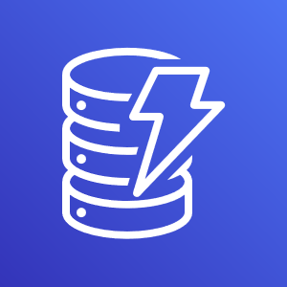




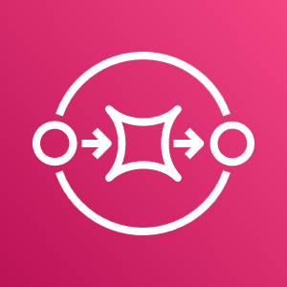


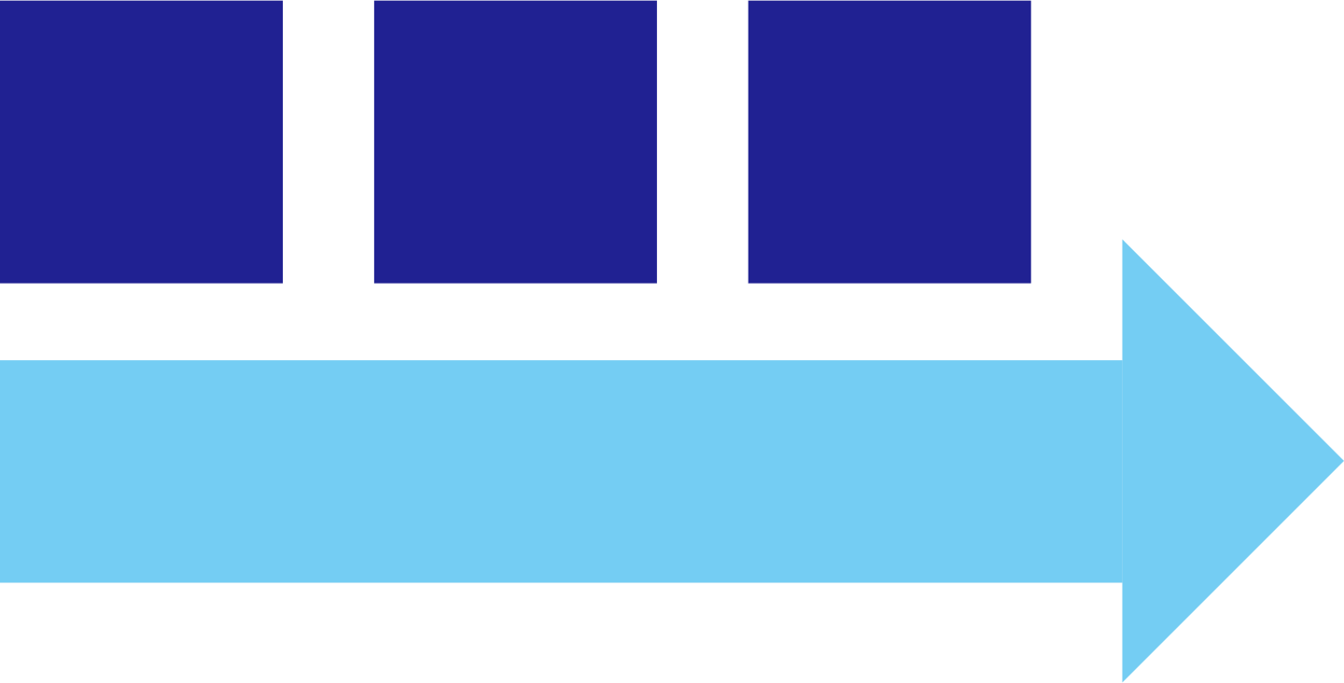
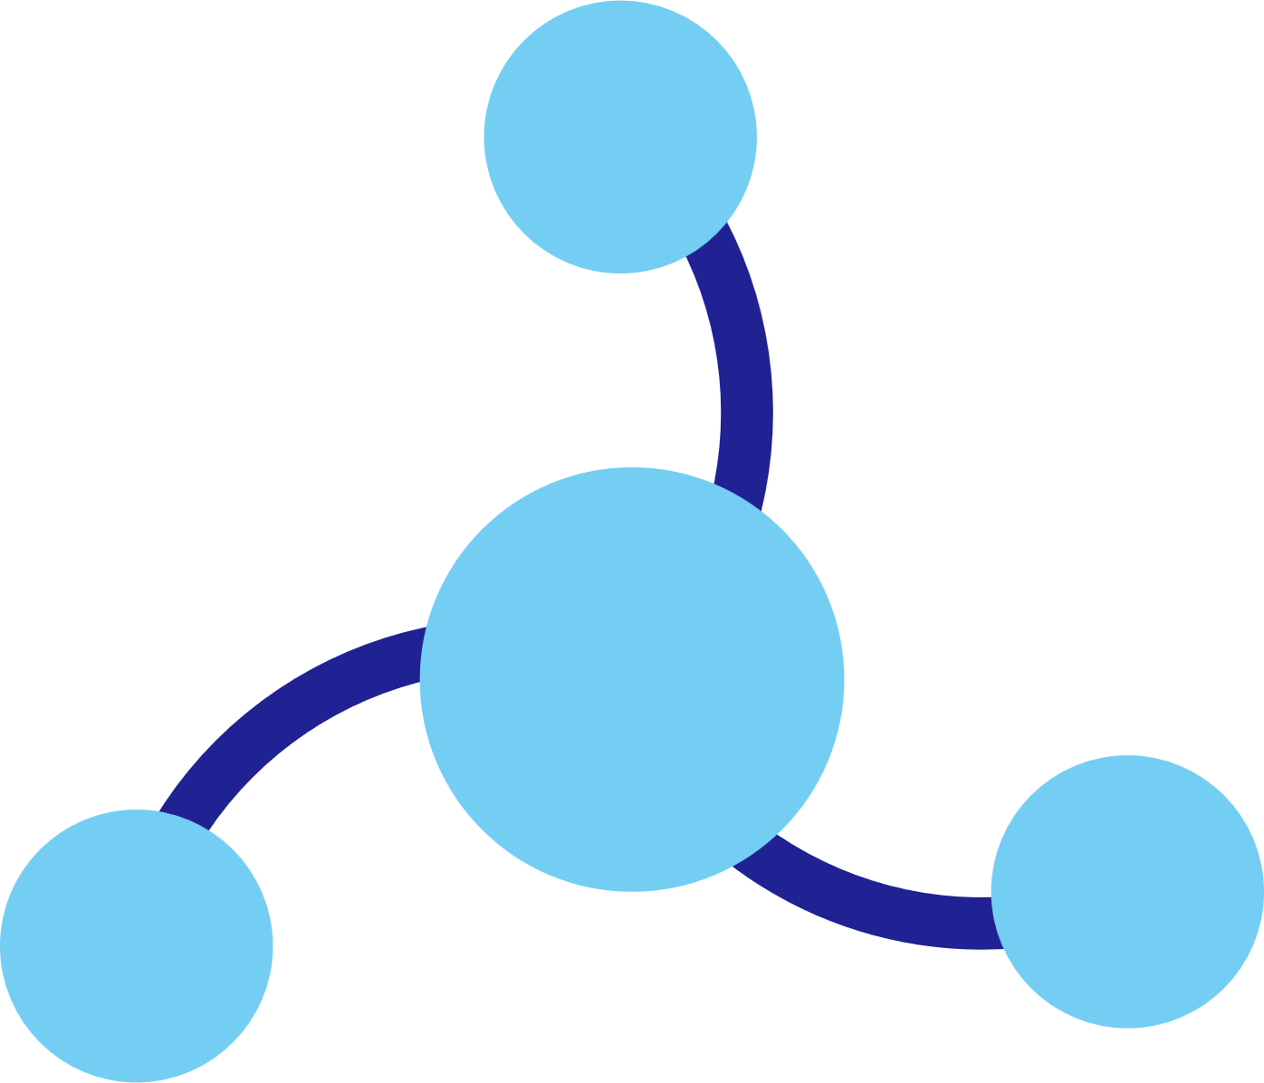


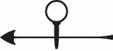

Dapr components
State
Stores
Containerized application
sidecar
AWS
DynamoDB
Azure
CosmosDB
Firebase
Redis
Cassandra
PubSub
Brokers
AWS
SQS
Azure
Service Bus
GCP
Pub/Sub
Redis
RabbitMQ
Swappable YAML files with
resource connection details
Over 70 components available
Create components for your resource at: github.com/dapr/components-contrib
Observability
Prometheus
AppInsights
Zipkin
Jaeger

Slide 25
Service to service invocation
Environment
Container app 1
Fully managed Dapr APIs provide a rich set of capabilities and productivity gains
Containerized application
sidecar
Dapr API
HTTP of gRPC
Service to service call
Container app 2
POST
http://localhost:3500 /v1.0/invoke/app2
Containerized application
sidecar
Dapr API
HTTP of gRPC
Notes:
Azure Container Apps offers a fully managed version of the Dapr APIs. With Dapr for Azure Container Apps, sidecars can be enabled to run next to your application instances and provide a rich set of capabilities and productivity gains

Slide 26
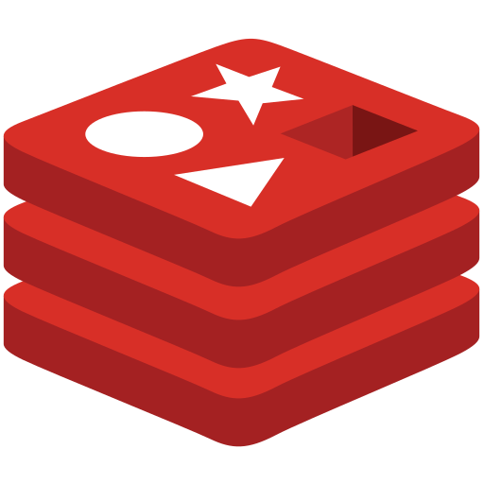

Environment
Container app 1
State management
Any Dapr state store
Redis cache
Firebase
Azure Cosmos DB
Dapr provide apps with state management capabilities for CRUD operations, transactions and more
Containerized application
sidecar
Dapr API
HTTP of gRPC
POST
http://localhost:3500/v1.0/state/corpdb
[{
"key": “fruit",
"value": “Orange"
}]
Notes:
Dapr integrates with existing databases to provide apps with state management capabilities for CRUD operations, transactions and more. It also supports the configuration of multiple, named, state store components per application. A state store in Dapr is described using a Component file.

Slide 27
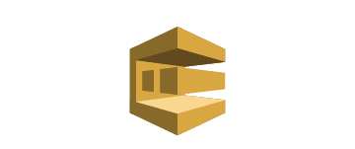
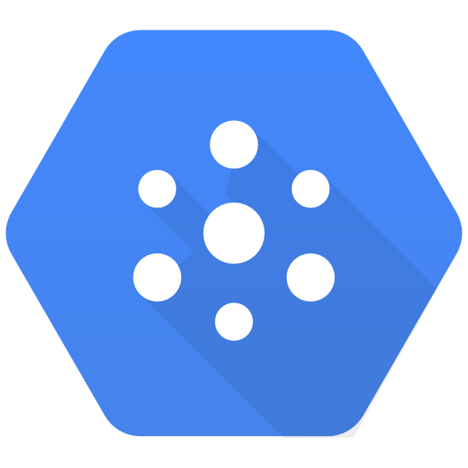


Environment
Cart app (Publish)
Publish and subscribe
AWS SQS
GCP Pub/Sub
Any Dapr pub/sub
Azure Event Hub
Create event-driven, loosely coupled architectures where producers send events to consumers via topics.
Containerized app
sidecar
Dapr API
HTTP of gRPC
POST
http://localhost:3500/v1.0/state/corpdb
Shipping app (Subscribe)
[{
"key": “fruit",
"value": “Orange"
}]
Containerized app
sidecar
Dapr API
HTTP of gRPC
Notes:
The publish/subscribe pattern allows microservices to communicate with each other using messages. The producer or publisher sends messages to a topic without knowledge of what application will receive them. This involves writing them to an input channel. Similarly, a consumer or subscriber subscribes to the topic and receive its messages without any knowledge of what service produced these messages. This involves receiving messages from an output channel. An intermediary message broker is responsible for copying each message from an input channel to an output channels for all subscribers interested in that message. This pattern is especially useful when you need to decouple microservices from one another.
The publish/subscribe API in Dapr provides an at-least-once guarantee and integrates with various message brokers and queuing systems. The specific implementation used by your service is pluggable and configured as a Dapr pub/sub component at runtime. This approach removes the dependency from your service and, as a result, makes your service more portable and flexible to changes.

Slide 28

Environment
Container app 1
Container app 2
Observability
Containerized application
sidecar
Service to service call
sidecar
Containerized application
Intercept traffic and extract tracing, metrics, and logging information. Configure Azure Application Insights for distributed tracing across your services
Collector
Azure Application Insights
Notes:
Dapr's sidecar architecture enables built-in observability features. As services communicate, Dapr sidecars intercept the traffic and extract tracing, metrics, and logging information. Telemetry is published in an open standards format. By default, Dapr supports OpenTelemetry and Zipkin.
With the OpenTelemetry collector, you can then configure Azure Application Insights for distributed tracing across your services.

Slide 29
Get started with Azure Container Apps today
https://aka.ms/containerapps
Notes:
You can learn more about Azure Container Apps, or try it for yourself, at Azure.com.

Slide 30

Build your apps in Azure
mask
Notes:
The future will be defined by accelerating innovation.
Today we talked about our latest innovation on cloud native and open source and shared exciting news about the next generation of containers and serverless apps that empower every developer to take advantage of flexible choices to create microservices applications on Azure.
We can’t wait to see what you build!
Thank you!

